Slide 1

Ethics and Compliance
Cynthia Isales, Ethics Liaison and Compliance Officer

Slide 2
Ethics
Code of Ethics for Public Officials
Who? state officials and employees (except judges)
What?
Use of state position
Gifts
Conflicts of Interest
Other Employment
Contracting with the State
Revolving Door

Slide 3

Ethics
Code of Ethics for Public Officials
Why?

Slide 4
Use of State Position
You may not use your state position for:
  Your own financial gain
  The financial gain of your family
(spouse, child, child’s spouse, parent,
sibling)
  The financial gain of an associated business

Slide 5
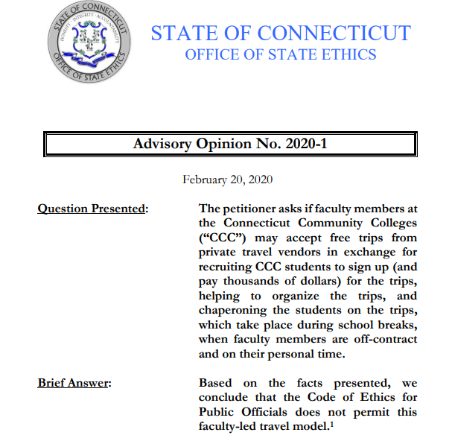
Advisory Opinion No. 2020-1

Slide 6
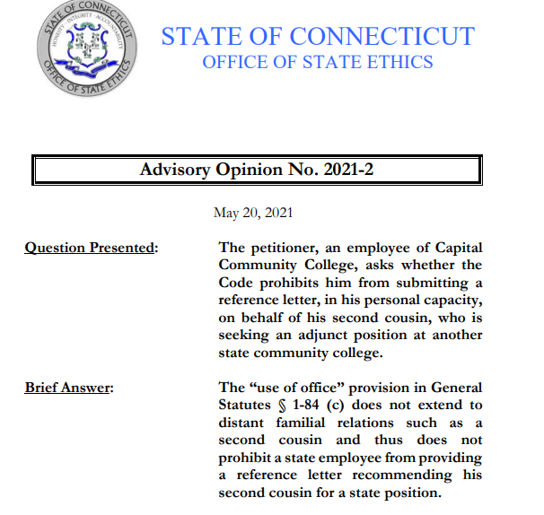
Advisory Opinion No. 2021-2

Slide 7
Gifts
What is a “gift”?
General Statutes § 1-79 (5) defines “gift” in three parts:
1. “anything of value” (for example, money, tickets to a sporting event, meals, services, etc.),
2. “which is directly and personally received” (that is, the state official or employee accepts the opportunity to partake of it),
3. “unless consideration of equal or greater value is given in return” (that is, unless the state official or employee pays fair market value for it).

Slide 8
Gifts
Restricted donors include:
Registered lobbyists (a list is available on the OSE website) or a lobbyist’s representative;
• Individuals or entities doing business CT State;
• Individuals or entities seeking to do business with CT State;
• Individuals or entities engaged in activities regulated by CT State; or
• Contractors pre-qualified by the Connecticut Department of Administrative Services (General Statutes § 4a-100).
Non-restricted donors/Look to reason for gift

Slide 9
Gifts
Gift Exceptions (19 Total)
Include:
Token items
Food and beverage
Rebates or discounts
Gifts to the state

Slide 10
Gifts
Supervisor/Subordinate
$99.99 limit
Exception: Major Life Event ($1,000)
Birth
Adoption
Wedding
Funeral
Retirement from state service
Induction into religious adulthood

Slide 11
Conferences
Necessary Expenses
You may accept payment or reimbursement of “necessary expenses” for your “active participation” in your role as a public official or state employee.
“Necessary expenses”
Travel (coach class)
Lodging (standard room nights before, of and after event)
Meals
Conference or seminar registration fees
“Necessary expenses” do not include recreation or entertainment costs.

Slide 12
Conferences
Necessary Expenses Reporting Requirement: If you receive payment or reimbursement of necessary expenses for lodging and/or out of state travel, you must file a form (ETH-NE) with the OSE within 30 days.

Slide 13
Conflicts of Interest - Substantial
“substantial conflict… if he has reason to believe or expect that he, his spouse, a dependent child, or a business with which he is associated will derive a direct monetary gain or suffer a direct monetary loss, as the case may be, by reason of his official activity.”
Recusal + Written Statement

Slide 14
Conflicts of Interest - Potential
“Any public official or state employee, other than an elected state official, who, in the discharge of such official's or employee's official duties, would be required to take an action that would affect a financial interest of such official or employee, such official's or employee's spouse, parent, brother, sister, child or the spouse of a child or a business with which such official or employee is associated, other than an interest of a de minimis nature… has a potential conflict of interest.”
Recusal + Written Statement

Slide 15
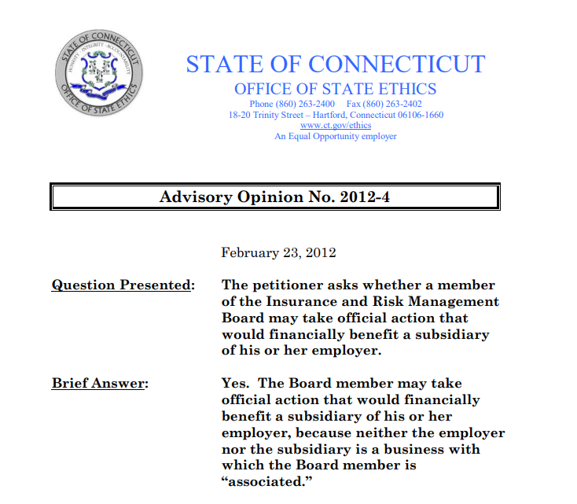

Conflicts of Interest

Slide 16
Must not impair your independence of judgment
May not lead to the disclosure of confidential information
May not lead to a use of state position for the benefit of the outside employer
Note about teleworking
Outside employment

Slide 17
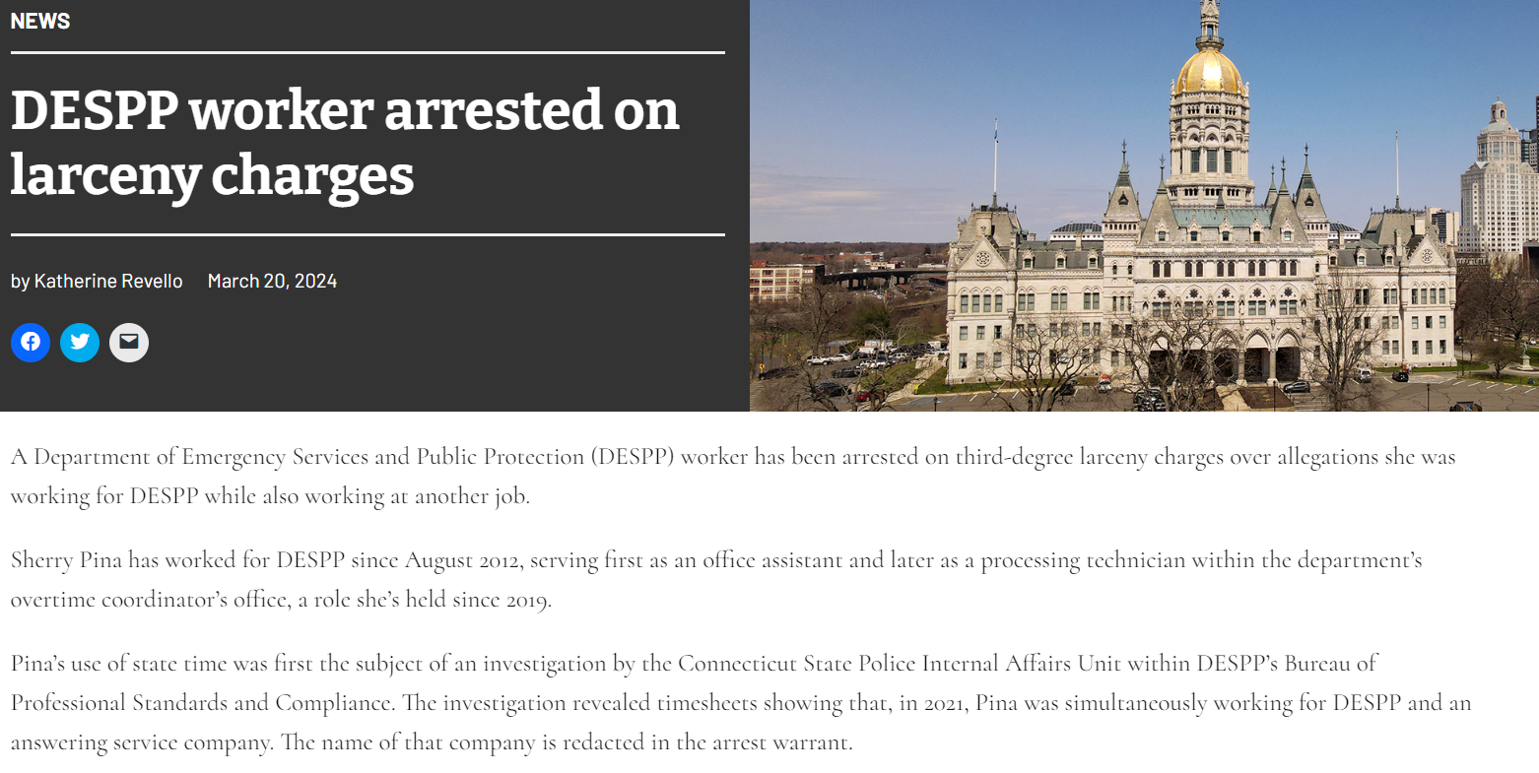




Outside employment

Slide 18
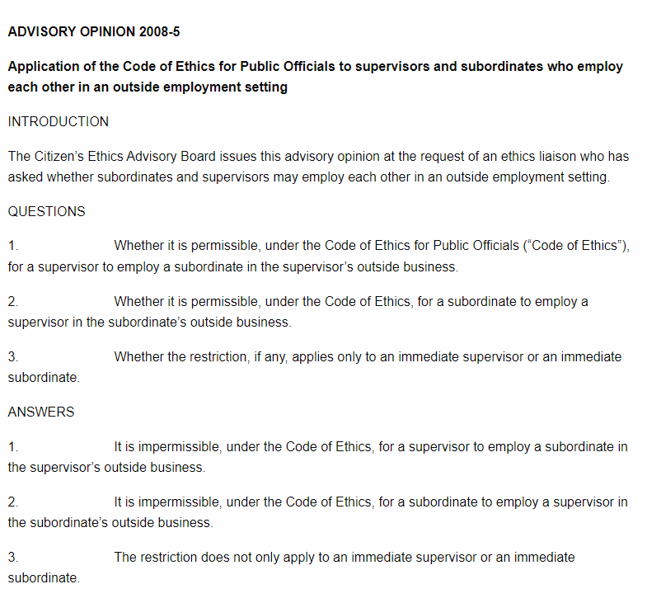
Outside employment

Slide 19
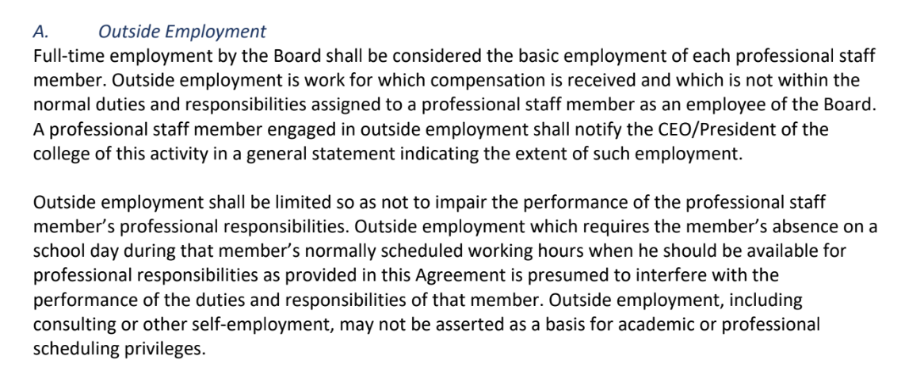
Outside employment
4C’s Contract Language

Slide 20
May not represent others for compensation before 11 listed state regulatory agencies
May not be a member or employee of an entity that is in the business of representing others for compensation before those agencies.
Department of Banking
The Claims Commissioner
The Office of Health Care Access division within the Department of Public Health
The Insurance Department
The Department of Consumer Protection
The Department of Motor Vehicles
The State Insurance and Risk Management Board
The Department of Energy and Environmental Protection
The Public Utilities Regulatory Authority
The Connecticut Siting Council, or
The Connecticut Real Estate Commission.
C.G.S. § 1-84 (D)

Slide 21
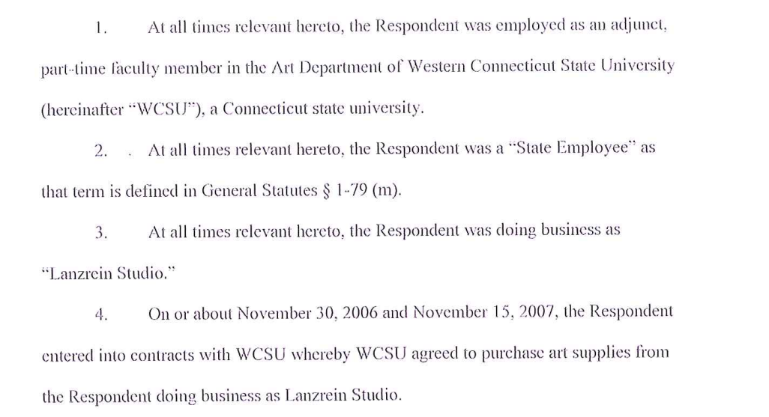
Cannot enter into a contract with the state, valued at one hundred dollars or more unless the contract has been awarded through an open and public process
Contracts with the state
From Ethics Enforcement Docket No. 2009-70:

Slide 22
Docket No. 2021-41 In the Matter of a Complaint against Jotham Burrello. On August 23, 2022, the OSE and the Respondent entered into a Settlement Agreement, resolving allegations of violations of Section 1-84 (c) which prohibits a state employee from using state resources for financial gain and Section 1-84 (i) which prohibits a state employee and/or the employee’s associated business from entering into state contracts valued at $100 or more unless such contracts are awarded through an open and public process. The Respondent, a faculty member of the English Department at Central Connecticut State University (“University”), violated Section 1-84 (i) when, on behalf of his private business, he entered into three contracts with the University for services related to literary festivals organized by the University, including the advertising, marketing, and editorial supervision of the festival anthologies. The Respondent also violated Section 1-84 (c) when he used his state position to submit payment request forms and associated documentation to the University in order to secure payments to his business; and, to solicit outside funding through the University Foundation that was ultimately paid to his business. The Respondent denied any violation of the Code of Ethics. However, under the terms of the settlement, he agreed to pay a civil penalty of $1,000.
Contracts with the state

Slide 23
The answer to your first question, then, is yes: If a community college seeks to enter a contract with a state employee in order for the latter to provide professional development, the contract must proceed via § 1-84 (i)’s open-and-public process if it is valued at $100 or more.
Turning to your second question—i.e., “What are the criteria for a contract process to be considered an ‘open and public process?’ ”—the answer stems from Advisory Opinion No. 2002-8, in which the Commission concluded, in relevant part, as follows:
With the new computer technology and accessibility . . . a state agency with a contract opportunity can satisfy the prior public offer requirement of §1-84(i) by posting the opportunity on its public web site and also on the Department of Administrative Services’ Procurement/Purchasing web site. This dual posting will not only provide a public advertisement of the opportunity to potential vendors who check the agency’s site, but will also provide a more generalized public advertisement on the state web site dedicated to contract procurement. Also, of course, the agency must comply with any more stringent bid process rules required either by the agency itself or by the Department of Administrative Services.
Contracts with the state

Slide 24
Post-State Employment (Revolving Door)
Two lifetime provisions
Confidential Information: You may never disclose any confidential information you learned during the course of your state service for anyone’s financial gain. General Statutes § 1-84a. “Confidential information” is defined by Regs., Conn. State Agencies § 1-81-15.
Side-Switching: You may never represent anyone other than the state regarding a particular matter in which you were personally or substantially involved while in state service and in which the state has a substantial interest. This prevents side-switching in the midst of on-going state proceedings. General Statutes § 1-84b (a).
Revolving Door

Slide 25
Post-State Employment (Revolving Door)
Two one-year provisions
Cooling-Off: You may not represent anyone, other than the state, for compensation before your former agency for a period of one year after leaving state service. General Statutes § 1-84b (b).
State Contracts: You are prohibited from being hired for a period of one year after you leave state service by a party to a state contract valued at $50,000 or more if you were substantially involved in, or supervised, the negotiation or award of that contract and it was signed within your last year of state service. General Statutes § 1-84b (f).
Revolving Door

Slide 26
Who Must File:
1. Statutorily designated individuals. General Statutes § 1-83 (a) (1); and
2. Members of the Executive Department and employees of quasi-public agencies designated by the Governor.
What information must be provided:
businesses with which you are associated and certain of their affiliates;
the category or type (not amount) of all sources of income over $1,000;
securities in excess of $5,000;
real estate holdings;
blind trusts; and
leases or contracts with the state or quasi-public agencies.
A confidential portion of the statement requires disclosure of sources of any debts over $10,000. (The confidentiality of this portion may be waived.)
Statements of Financial Interests

Slide 27
Initiated by a complaint, filed by the Ethics Enforcement Officer or any member of the public. In most cases, a complaint by the Ethics Enforcement Officer is preceded by a confidential staff evaluation.
Civil penalty -- $10,000 per each violation
Mandatory Reporters
Commissioners and Deputy Commissioners;
State Agency Heads and Deputy Heads;
Quasi-public Agency Heads and Deputy Heads;
Persons in charge of state agency procurement and contracting; and
Persons in charge of state agency human resources.
Enforcement of the Code of Ethics

Slide 28
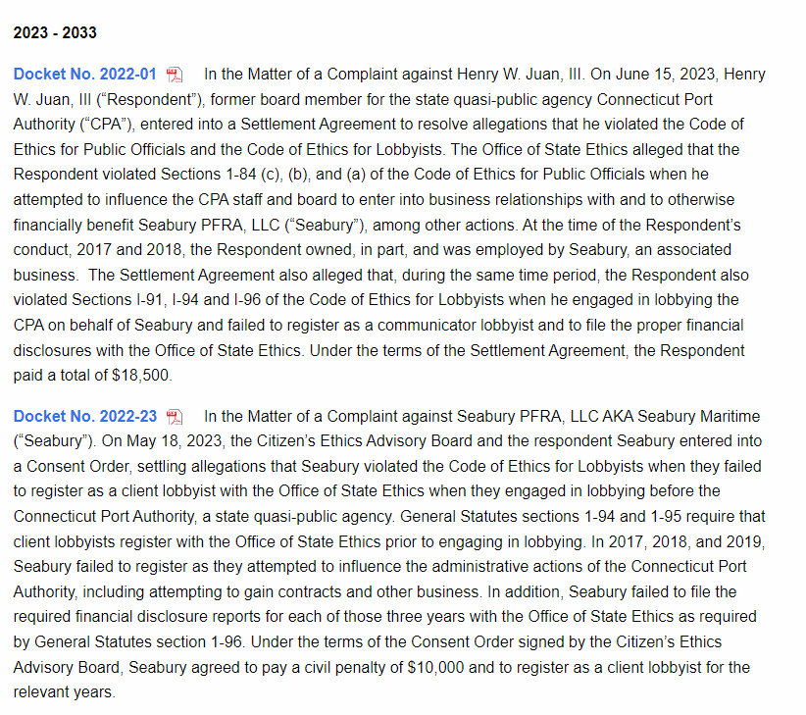






Enforcement of the Code of Ethics

Slide 29
Office of State Ethics
ethics.code@ct.gov
ethics.enforcement@ct.gov
165 Capitol Avenue
Suite 1200
Hartford CT 06106
Phone Number: 860-263-2400
Your Ethics Liaison
Cynthia Isales
Cynthia.isales@ctstate.edu
185 Main Street
New Britain CT 06051
860-305-2164
Your Ethics Policies
BOR 407 Ethics Statement
BOR 4.6 Policy Regarding Nepotism in Employment
BOR 4.10 Code of Conduct for Regents, Employees and Volunteers
Contact Information

Slide 30
Other areas of compliance
Freedom of Information
The Freedom of Information Commission was created by the General Assembly in l975 with the passage of the Freedom of Information Act. The Act provides the public with rights of access to records and meetings of public agencies.
Records Management
Pursuant to Connecticut General Statutes §§ 11-8b and 7-109, records shall not be removed, destroyed, mutilated, transferred or otherwise damaged or disposed of, in whole or in part, except as provided by law or under the rules established by the Office of the Public Records Administrator. Pursuant to Connecticut General Statutes §§ 1-240 and 53-153, unauthorized removal or destruction of records is a misdemeanor or felony offense and is punishable by fine or imprisonment.
Please refer to the following Policy for further guidance: Public Records Policy 05: Disposition of Public Records.
Compliance

