Slide 1

CSCU Office Of Transfer and Articulation
CT State Spring 2025

Slide 2


Office of Transfer and Articulation
Topics for discussion:
Office Vision
Work in progress
  STEP
  CSCU General Education Transfer Credit Alignment Policy
  Universal Transfer Explorer
  Course Articulation and Review Schedule Recommendation

Slide 3
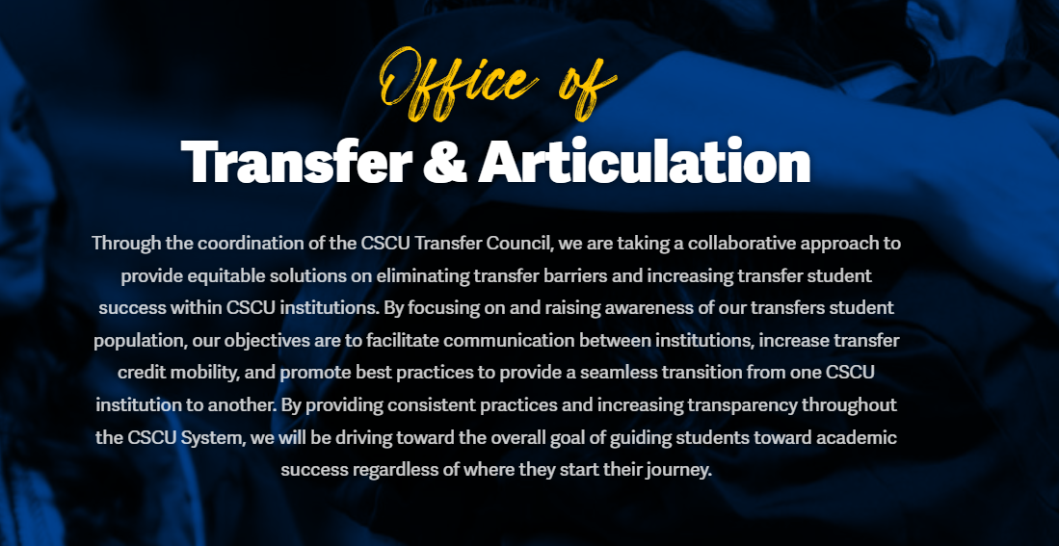
Office of Transfer and Articulation

Slide 4
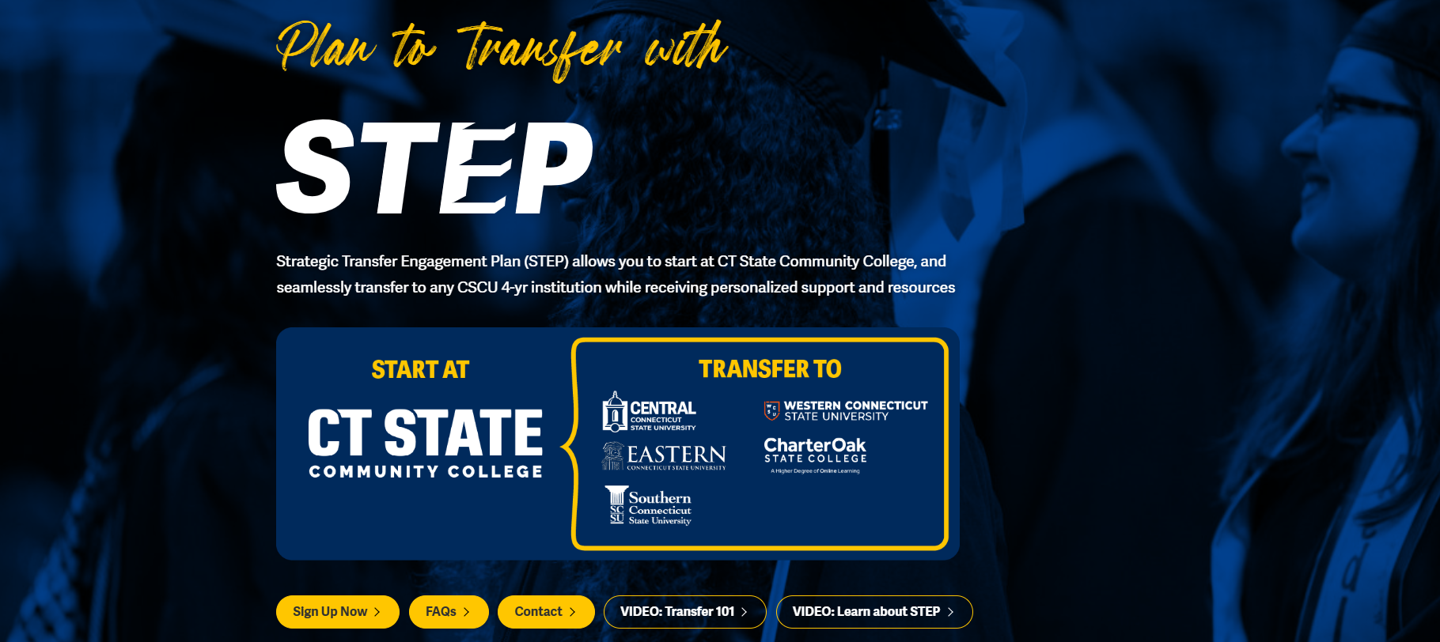
Strategic Transfer Engagement Plan (STEP)
https://www.ct.edu/transfer/step

Slide 5
Strategic Transfer Engagement Plan (STEP)
What is STEP?
A comprehensive plan to identify CT State students’ transfer intentions, determine where they would like to transfer, when they would like to transfer by, and identify the academic area that they are interested in.
What is the Goal?
Increase vertical transfer rates from CT State to CSCU institutions
Increase baccalaureate degree completion at CSCU institutions by 7% by 2030

Slide 6
Strategic Transfer Engagement Plan (STEP)
Testing Approach for STEP
Testing is being approached using improvement science – small tests of change (National Association of Higher Education Systems aka NASH)
Testing began in Spring 2024
  March 24 with 5 GP advisors at Tunxis and expanded to include 5 GP Advisors at Naugatuck in June 24.
  In the Spring/Summer 64 STEP Transfer Intent Forms were completed.
Expanded Testing for the Fall 2024 at Tunxis to all enrolled students with 0-30 credits
  Leveraging CCS 1001 to get STEP resources to students- Week 13
  Meeting bi-weekly with CAL and GPA II
As of February 7, 926 STEP Transfer Intent forms (838 individual students) - this includes the original 64 from Spring testing

Slide 7
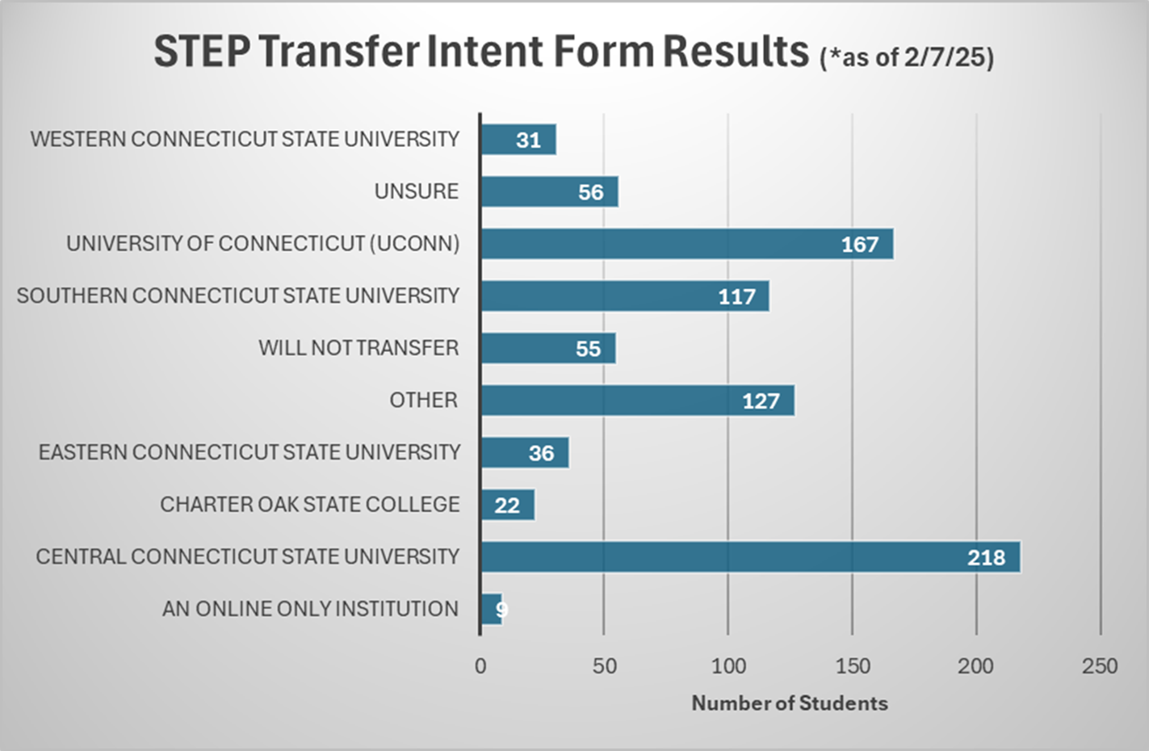
Strategic Transfer Engagement Plan (STEP)

Slide 8
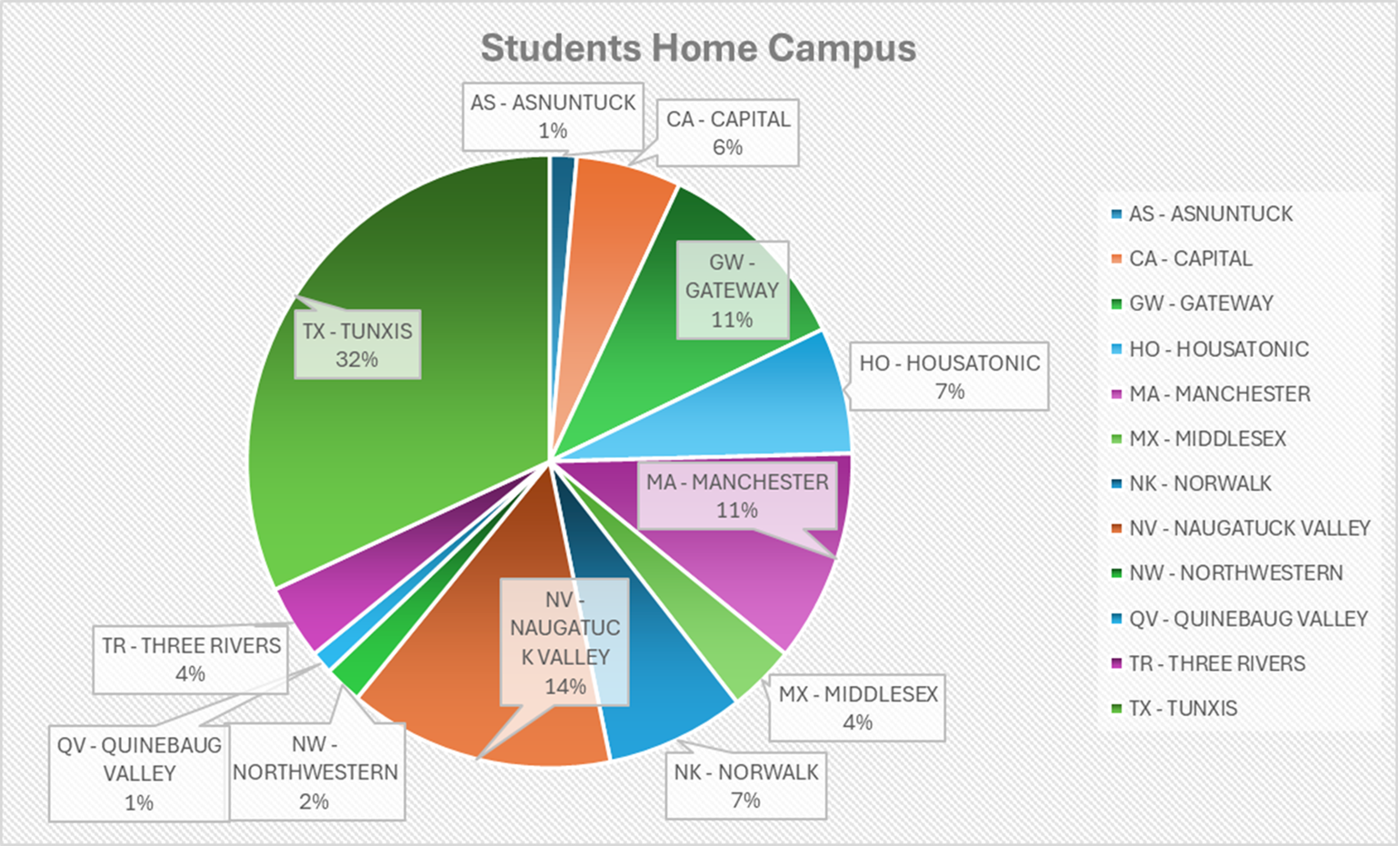
Strategic Transfer Engagement Plan (STEP)

Slide 9
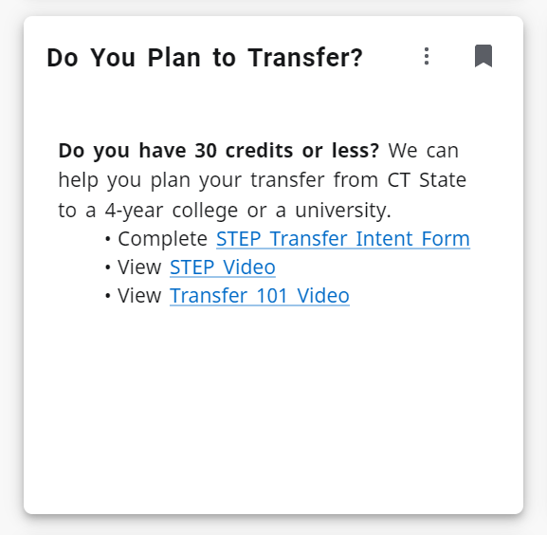






Strategic Transfer Engagement Plan (STEP)
"Systemness"- Collaborative approach
STEP Transfer Intent Form
Data Collection
Sharing records
Transfer Guide
"Do you Plan to Transfer?" tile launched on the myCTstateportal on September 19th and is available to students at all 12 CT State campuses

Slide 10

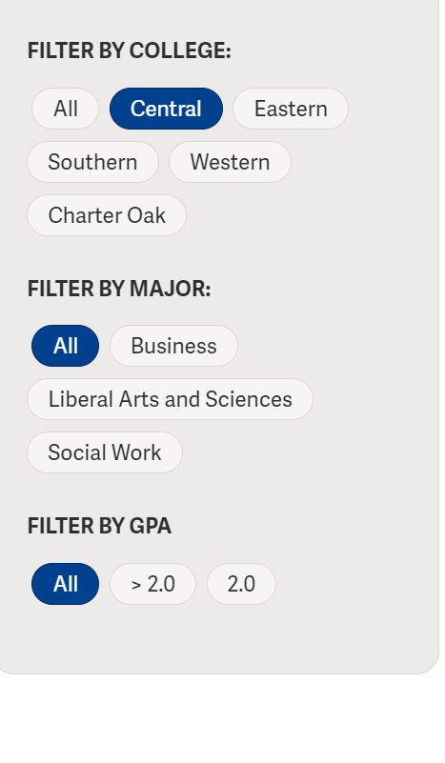
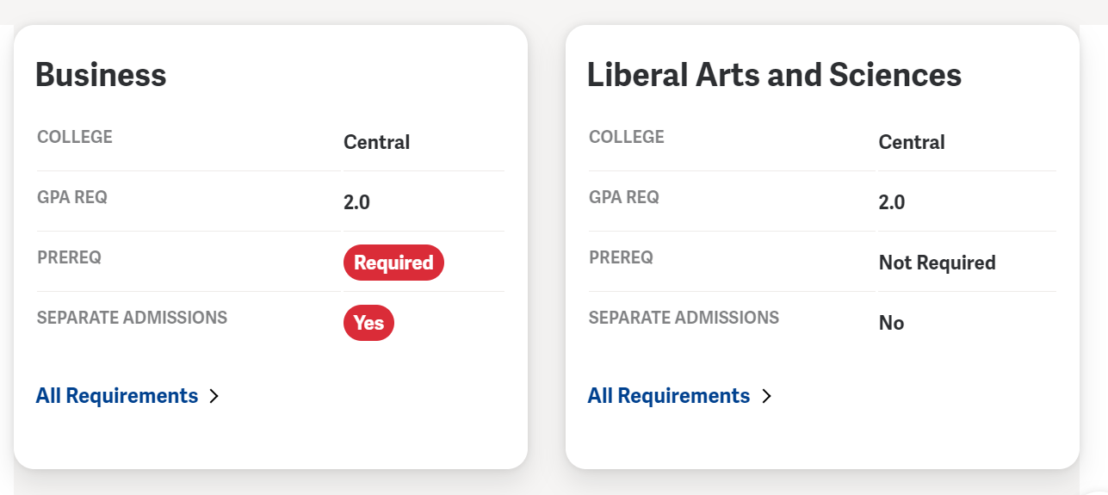
Strategic Transfer Engagement Plan (STEP)
Pre-Requisites
Pre-major pathway
Encumbered Gen Eds
Pre-major
Math
Internship
Foreign Language
Admissions Contact at 4-year

Slide 11
Simplifying Academic Planning
What is the problem that we are trying to solve?
How can we improve academic planning by simplifying the process?
What has been done and what is in progress?
General Transfer Credit Alignment Policy
Transfer Explorer
Course Articulation and Review Schedule

Slide 12
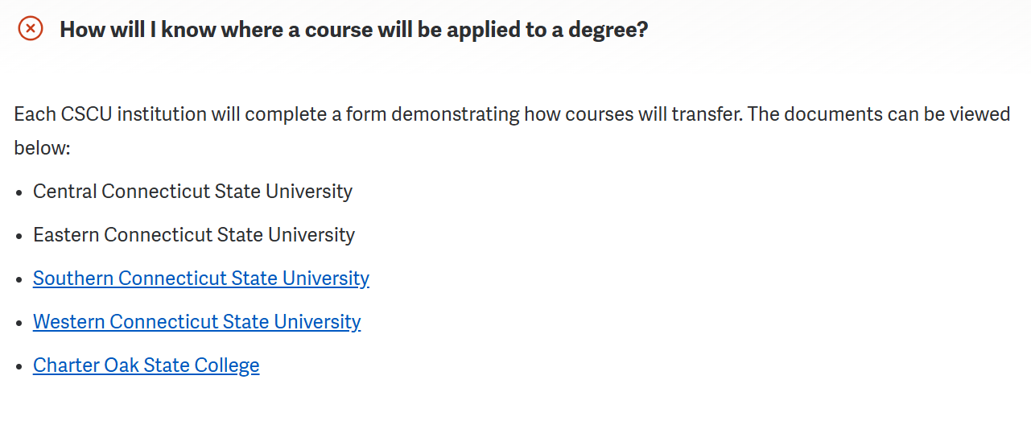
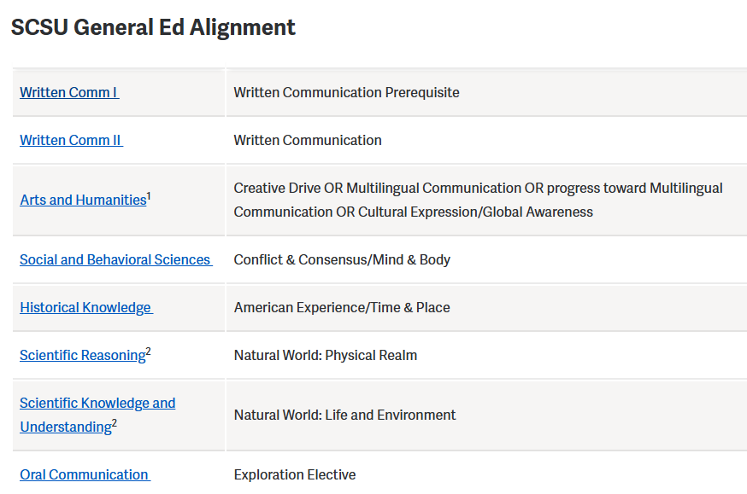

CSCU GENERAL EDUCATION TRANSFER
CREDIT ALIGINMENT
How It Works (https://www.ct.edu/ota/gened)

Slide 13
Universal Transfer Credit Explorer
Transfer Explorer
Grant based project lead by ITHAKA S+R in collaboration with CUNY
  One stop experience to evaluate course equivalencies for all six institutions
  Provides information on course applicability and remaining credits for potential transfer destination programs
  Establishes SIS integration with ITHAKA servers to provide up to date and accurate catalog and course equivalency information

Slide 14
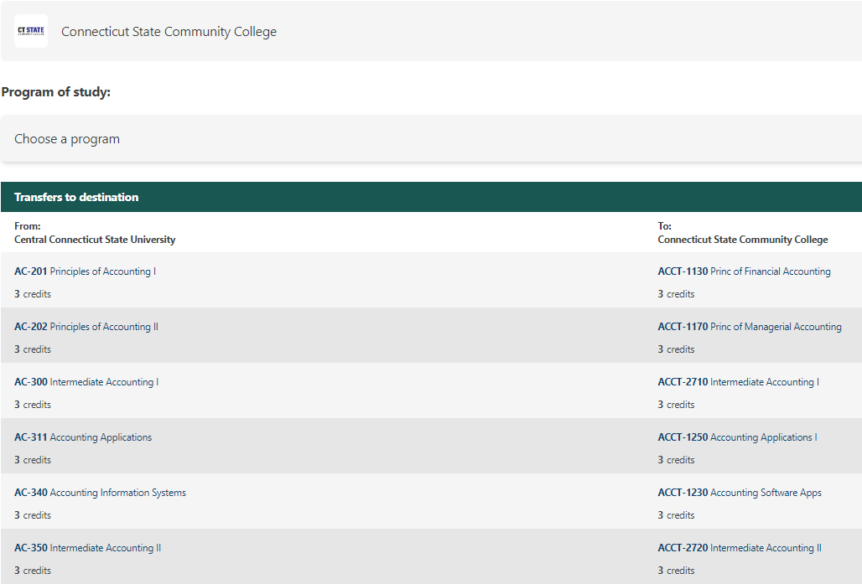
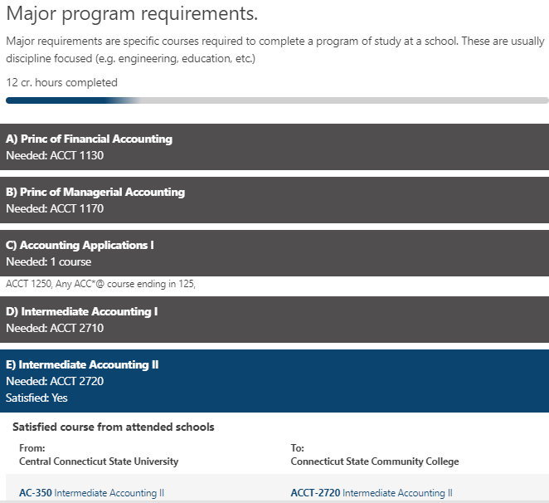
Universal Transfer Credit Explorer

Slide 15
CSCU Course Articulation and Review Schedule Recommendation
CSCU Course Articulation and Review Schedule
Recommendation passed and submitted by the CSCU Transfer Council April 2024
  Sets a guidelines on how transfer courses are evaluated as comparable courses offered at receiving institutions
  Levels the playing field for transfer grades to be accepted and applied as they would for a non-transfer student
  Establishes a review cycle for course within academic areas to be evaluated on a regular basis

Slide 16
Odds and Ends
Other work in progress:
Exploring improvements for Cross Registration and Consortium opportunities
Third Party Transfer Requests
Pre-Program Degrees

Slide 17

We welcome your questions.

